Slide 1




SQL in Azure - IaaS vs PaaS
Deep dive into the most critical considerations for choosing the right Azure data platform for your SQL Server database engine.
ZORAN BARAC, Principal Data Architect @ CIN7
MCT, MCSE
zoran.barac.zof@gmail.com
blog.sqlserveronline.com
www.linkedin.com/in/zoran-barac/
www.meetup.com/Auckland-SQL-User-Group/

Slide 2
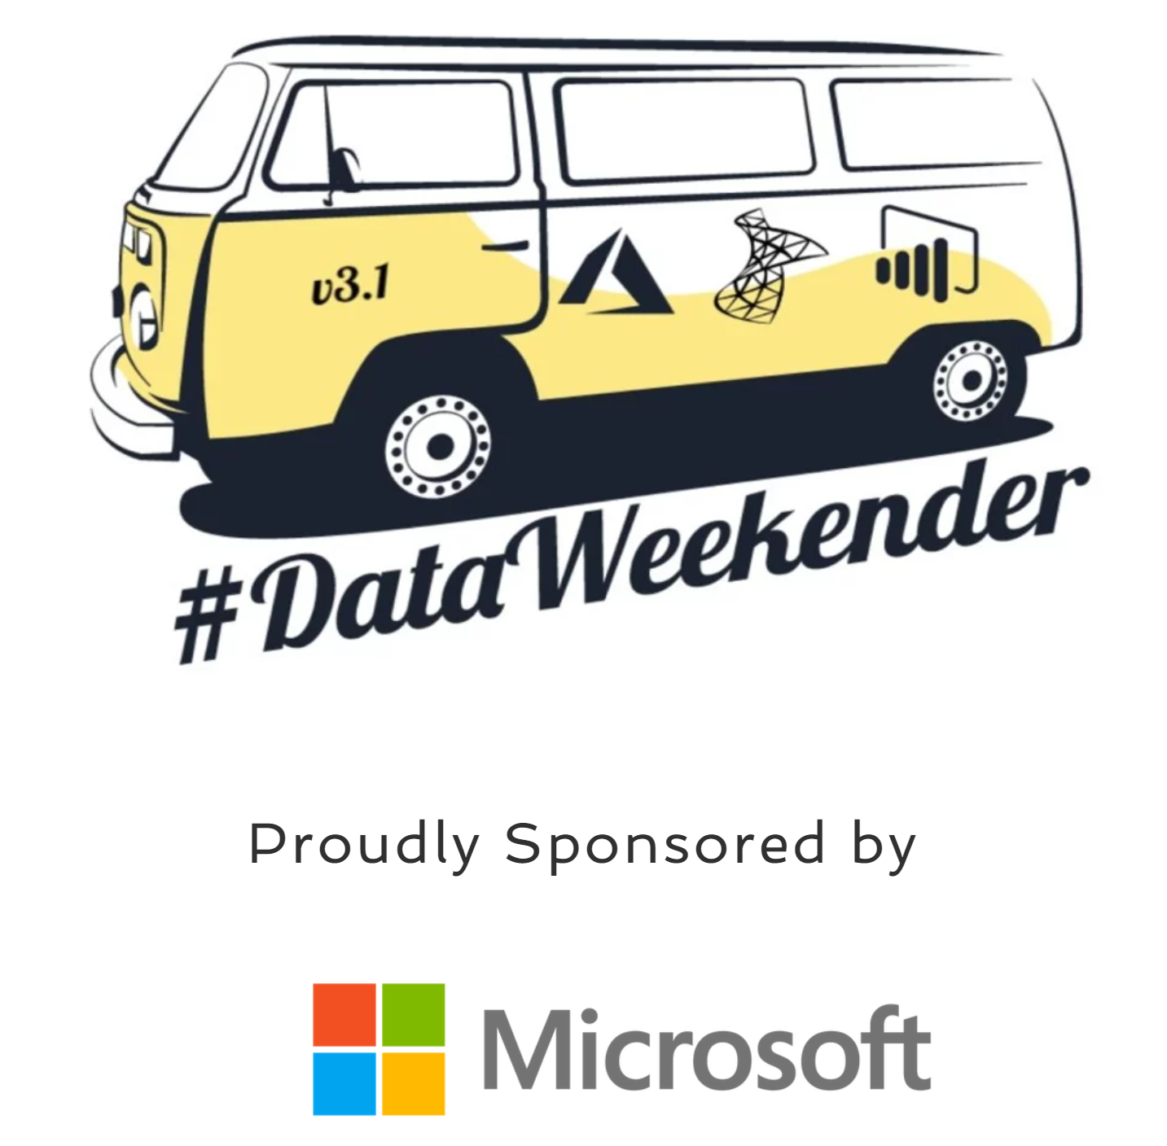

Slide 3
Agenda
Azure cloud models: IaaS, PaaS
Microsoft SQL data platforms
Cloud models: IaaS, PaaS
Azure cloud data platform differences
Which SQL option should I choose?
Target data platform selection
Infrastructure as a service (IaaS)
VM categories and series
Azure Portal – VM sizes
Disk capacity and storage performance and configuration for different workload types
Choose the right Azure VM size
Most common Storage and VM size configuration
HA architecture on Azure VM SQL Server
Platform as a service (PaaS)
What is Azure SQL?
vCore and DTU purchasing models
DTU purchasing model
Resource limits for the logical SQL server (Azure DB)
vCore model and service tiers options
Service tier characteristics SQL Azure
Service tier characteristics SQL MI
Compute and storage SQL MI
Azure SQL and Architectural Models
Architectural models that are used in Azure SQL
General Purpose service tier availability
Business Critical service tier availability
Read-only replicas and read-only query workloads
Virtual cluster connectivity architecture SQL MI
Custom Architecture Azure SQL DB
Data Migration Assistant (DMA)
DMA main functionalities
Data Migration Assistant (DMA) - Assessment
DMA / Instance Level – Azure SQL Database / Azure SQL MI
SQL Server feature parity – unsupported features example
DMA / DB Level – Azure SQL Database / Azure SQL MI

Slide 4
Azure cloud models: IaaS, PaaS
Microsoft SQL data platforms
Cloud models: IaaS, PaaS

Slide 5
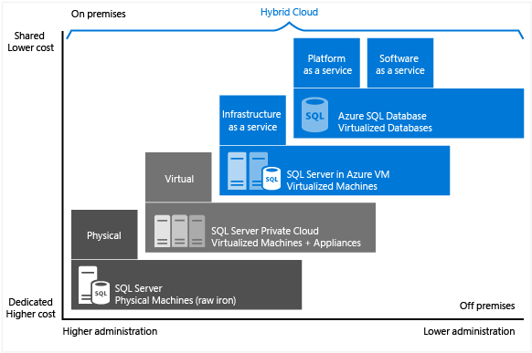
Microsoft SQL data platforms

Slide 6
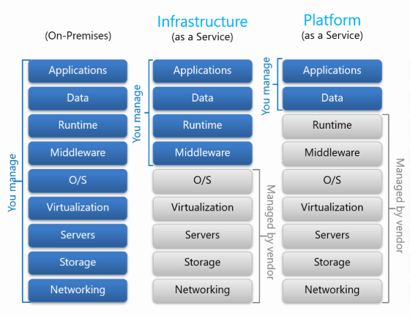
Cloud models: IaaS, PaaS

Slide 7

Azure cloud data platform differences
Which SQL option should I choose?
Target data platform selection

Slide 8
Which SQL option should I choose?
Azure SQL Database (PaaS) | SQL Managed Instances (PaaS) | SQL Virtual Machines (IaaS)
PROS: 99.995% availability guaranteed. Built-in backups, patching, recovery. Latest stable Database Engine version. Online change of resources (CPU/storage). The most commonly used SQL Server features are available. Ability to assign necessary resources (CPU/storage) to individual databases. CONS: Migration might be hard. Some SQL Server features are not available. Private IPs cannot be assigned (you can limit the access using firewall rules). | PROS: 99.99% availability guaranteed. Built-in backups, patching, recovery. Latest stable Database Engine version. Online change of resources (CPU/storage). Supports almost all on-premises instance/database level capabilities. High compatibility with SQL Server on-premises. Easy migration from SQL Server. Private IPs within Azure VNet. CONS: There is still some minimal number of SQL Server features that are not available. | PROS: Up to 99.99% availability. Supports all on-premises capabilities. You have full control over the SQL Server engine. Full parity with the matching version of on-premises SQL Server. Fixed, well-known database engine version. Easy migration from SQL Server on-premises. CONS: You need to manage your backups and patches. You need to implement your own High-Availability solution. There is a downtime while changing the resources(CPU/storage)

Slide 9
Target data platform selection
Target platform | Indicators to look for | Unique Benefits
Azure SQL Database Single Database | Small number of databases or many databases but all with steady usage. | Lowest cost for single databases.
Azure SQL Database Elastic Pools | Many databases or multitenant deployments. Multiple databases that have variable usage patterns | Cost effective as pooled resources are shared amongst multiple databases.
Azure SQL Managed Instances | Do not own the application code or expensive to modify. Requires high level of compatibility. Uses features of SQL Server not yet supported by Azure SQL Databases. | Fully managed service whilst retaining high-level of compatibility with SQL Server. Supports SQL features such as cross-database queries which are unavailable in Azure SQL Database.
SQL Server on Azure Infrastructure as a Service | Use of features of SQL Server not yet supported by Azure SQL Databases. Third-party tools installed locally on SQL Server. | Fully compatible with on-premises SQL Server. Third-party applications and plug-ins highly likely to work as-is. Full access to underlying operating system to install third-party tools and services.

Slide 10
Infrastructure as a service (IaaS)
VM categories and series
Azure Portal – VM sizes
Disk capacity and storage performance and configuration for different workload types
Choose the right Azure VM size
Most common Storage and VM size configuration recommendations
HA on Azure SQL IaaS

Slide 11
VM categories and series
Categories
Compute optimized – High CPU to memory ratio (F, Fs , Fsv2-series)
General purpose – Balanced CPU to memory ratio (D, DS-series, etc)
GPU (NC, NCsv3, NVv3-series)
High performance compute – High CPU and memory, fastest and most powerful CPU (A, H-series)
Memory optimized – High memory to CPU ratio (D, DS, Ea, Eas, Ed, Eds, Es, G, Gs, M, Ms, Mds-series)
Storage optimized – High disk throughput and IO (Ls, Lsv2-series)

Slide 12
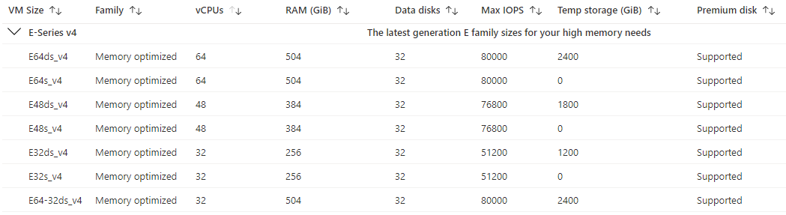
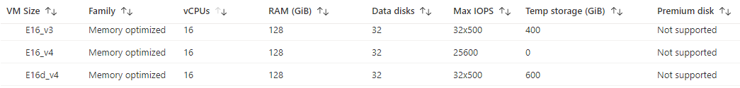
Azure Portal – VM sizes

Slide 13
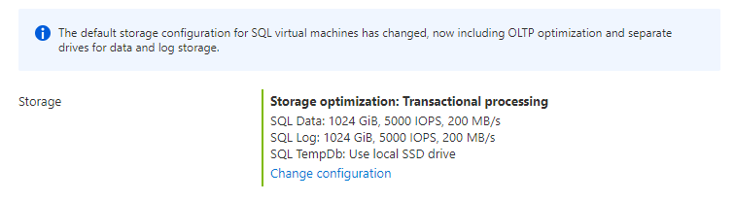
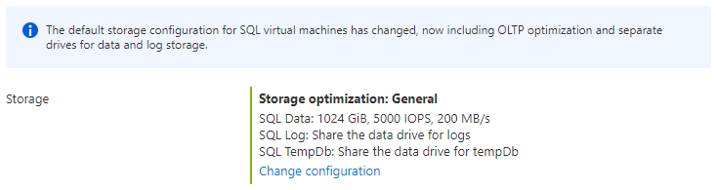
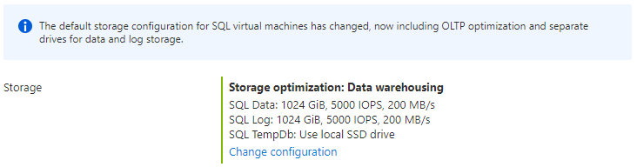
Disk capacity and storage performance and configuration for different workload types
Choose Premium Storage and the Right VM Size
Separate Data and Log Files
P30 disks (none cache) for Log
P30 disks (Read-Only cache enabled) for Data - With disk caching enabled on the premium storage disks, VMs can achieve higher levels of performance that exceed the underlying disk performance.
Temp DB on Local Disk (D:\ ephemeral drive)

Slide 14
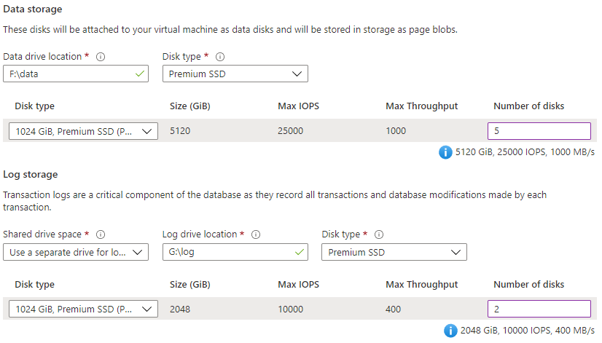
Choose the right Azure VM size
Example:
The selected VM size is E64-16s_v3
Warning:
The desired performance might not be reached due to the maximum virtual machine disk performance cap. The selected VM size (Standard_E64-16s_v3) only supports up to 1200 disk max throughput in MBps (currently 1400 in MBps).

Slide 15
Most common Storage and VM size configuration recommendations
Use memory optimized virtual machine sizes for the best performance of SQL Server workloads.
Use the Azure Virtual Machine marketplace images as the SQL Server settings and storage options are configured for optimal SQL Server performance.
Place data, log, and tempdb files on separate drives.
For the data drive, only use premium P30 and P40 disks to ensure the availability of cache support.
For the log drive try with P30 disks If sub-millisecond storage latency is required, use Azure ultra disks for the LDF.
In case of M-series VM consider Write Accelerator over using Azure ultra disks.
Place tempdb on the local ephemeral SSD D:\ drive after choosing the optimal VM size.
Stripe multiple Azure data to increase I/O bandwidth up to the target virtual machine's IOPS and throughput limits.
Set host caching to read-only for data file disks.
Set host caching to none for log file disks.
Format your data disk to use 64 KB allocation unit size for all data files

Slide 16
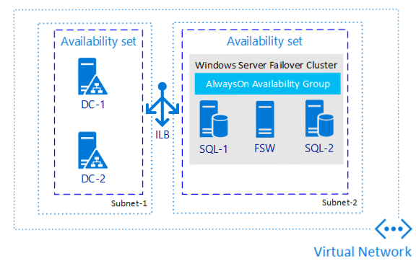
Always On AG architecture on Azure VM SQL Servers
Availability sets help protect against within datacenter downtime events by automatically deploying virtual machines across fault domains and update domains. Virtual machines must be added to an availability set when the VM is created.

Slide 17
Platform as a service (PaaS)
What is Azure SQL?
vCore and DTU purchasing models
DTU purchasing model
Resource limits for the logical server used by Azure SQL Database
vCore model and service tiers options
Service tier characteristics SQL Azure
Service tier characteristics SQL MI
Compute and storage SQL MI

Slide 18
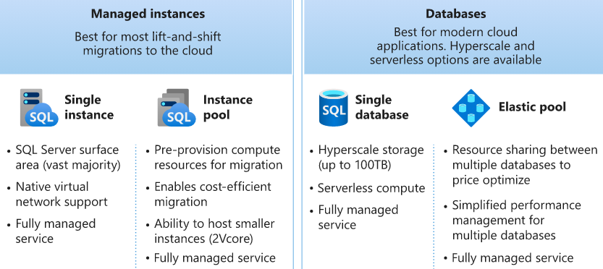
What is Azure SQL?

Slide 19
Resource limits for the logical server used by Azure SQL Database
Resource | Limit
Databases per logical server | 5000
Default number of logical servers per subscription in a region | 20
Max number of logical servers per subscription in a region | 200
DTU / eDTU quota per logical server | 54,000
vCore quota per logical server | 540
Max pools per logical server | Limited by number of DTUs or vCores. For example, if each pool is 1000 DTUs, then a server can support 54 pools.
Note
To obtain more DTU/eDTU quota, vCore quota, or more logical servers than the default amount, submit a new support request in the Azure portal.

Slide 20
vCore and DTU purchasing models
Different purchasing models are available for different Azure SQL Database deployment models:
The single database and elastic pool deployment options in Azure SQL Database offer both the DTU-based purchasing model and the vCore-based purchasing model.
The managed instance deployment option in Azure SQL Database offers only the vCore-based purchasing model.
The Hyperscale service tier is available for single databases that are using the vCore-based purchasing model.

Slide 21
DTU purchasing model
Basic service tier - The Basic service has max 5DTU. Max storage is 2GB. IO latency (approximate) is 5 ms(read) and 10 ms(write). Max concurrent workers (requests) is 30 and Max concurrent sessions 300. For less demanding workloads.
Standard service tier - The Standard S0, S1 and S2 tiers provide less than one vCore (CPU). For CPU-intensive workloads, a service tier of S3 or greater is recommended. IO latency (approximate) is 5 ms(read) and 10 ms(write). 3000 DTUs. For workloads with typical performance requirements.
Premium service tier - More than 1 TB of storage (from P11 and up) in the Premium tier is currently available in almost all regions. IO latency (approximate) is 2 ms(read/write). 4000 DTUs. For IO-intensive workloads
Note
Limits/differences - Max concurrent sessions, Max concurrent workers (requests), Max in-memory OLTP storage (GB)

Slide 22
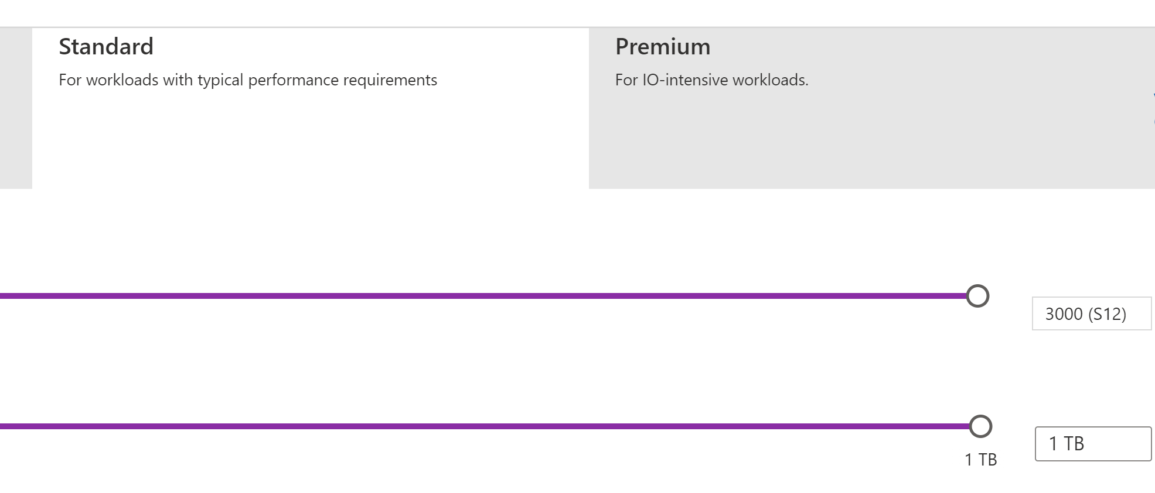
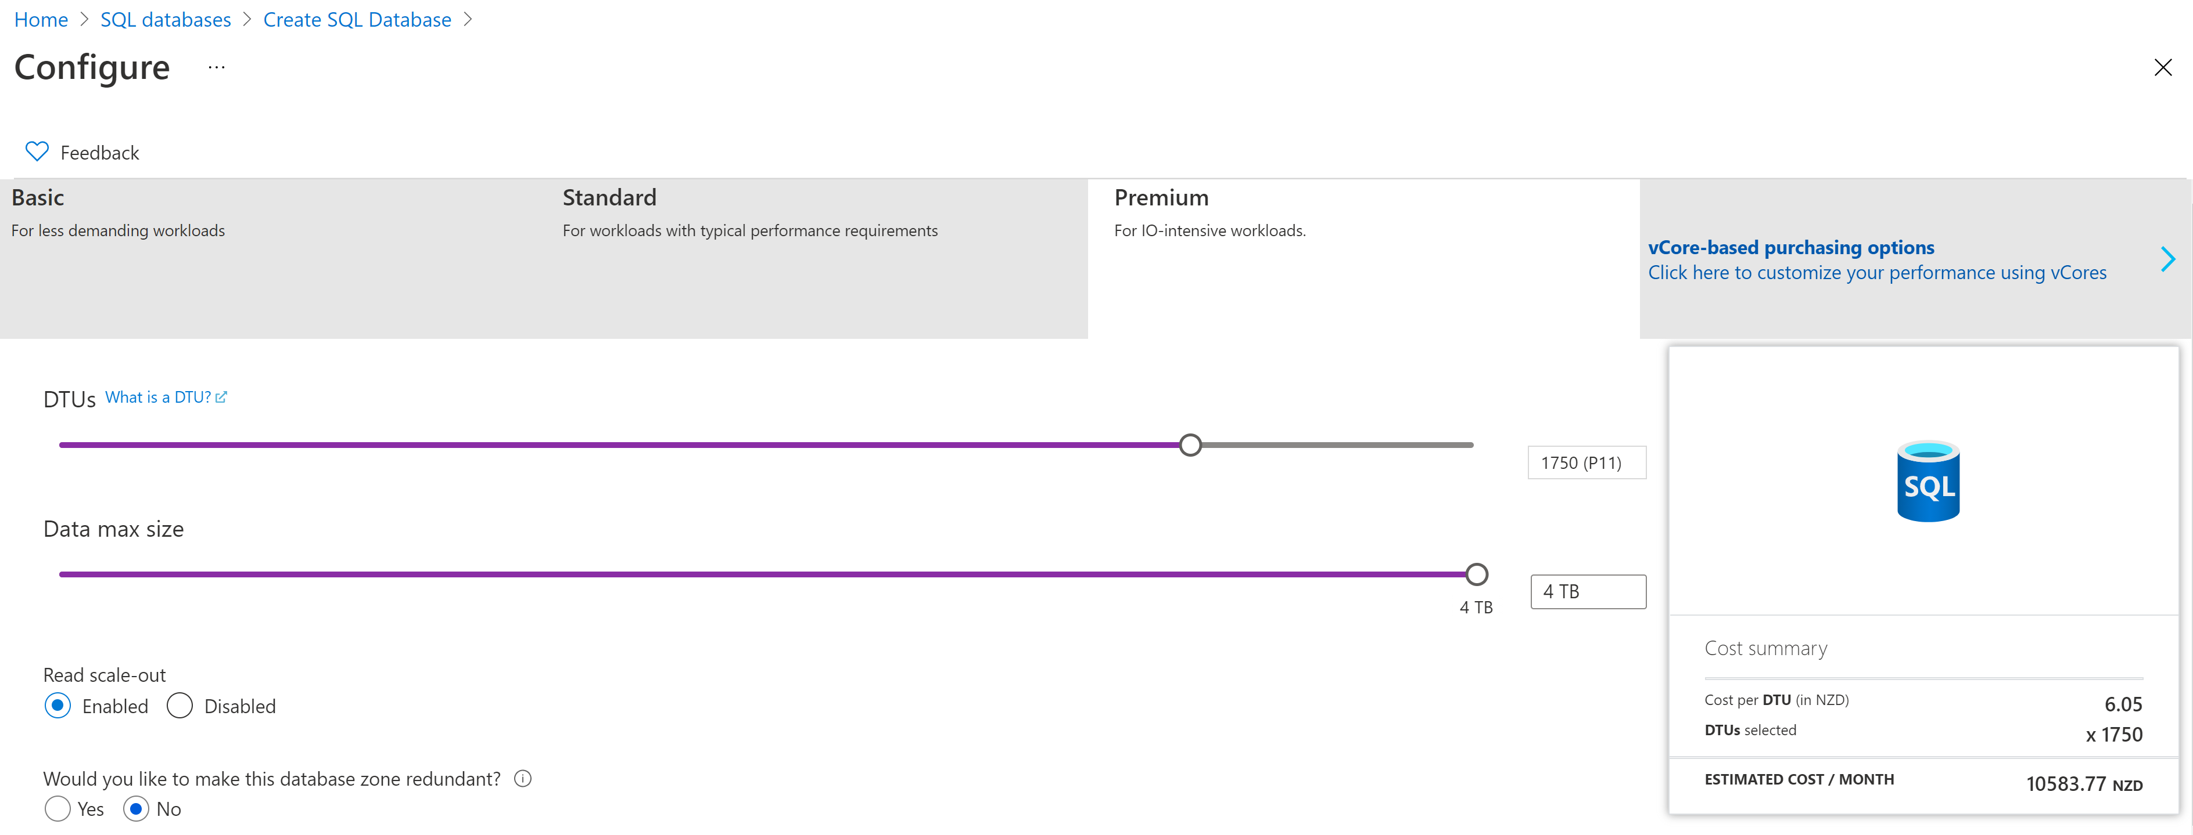
Azure SQL DB - DTU model and service tiers options

Slide 23
vCore model and service tiers options
Main characteristics of vCore model
Higher compute, memory, IO, and storage limits.
Control over the hardware generation to better match compute and memory requirements of the workload.
Pricing discounts for Azure Hybrid Benefit (AHB) and Reserved Instance (RI).
Greater transparency in the hardware details that power the compute;
Service tiers
Service tier options in the vCore model include General Purpose, Business Critical, and Hyperscale. The service tier generally defines the storage architecture, space and IO limits, and business continuity options related to availability and disaster recovery.

Slide 24
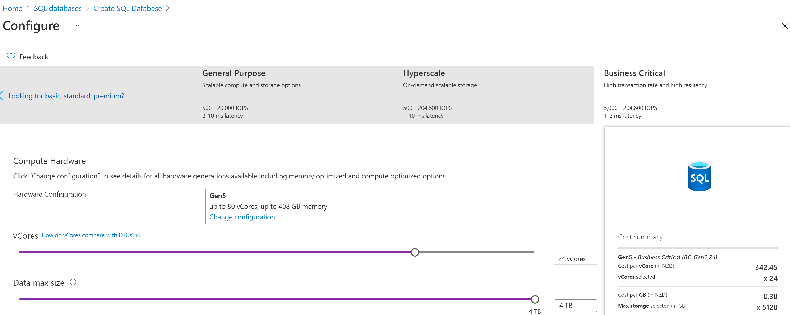
Azure SQL DB - vCore model and service tiers options

Slide 25
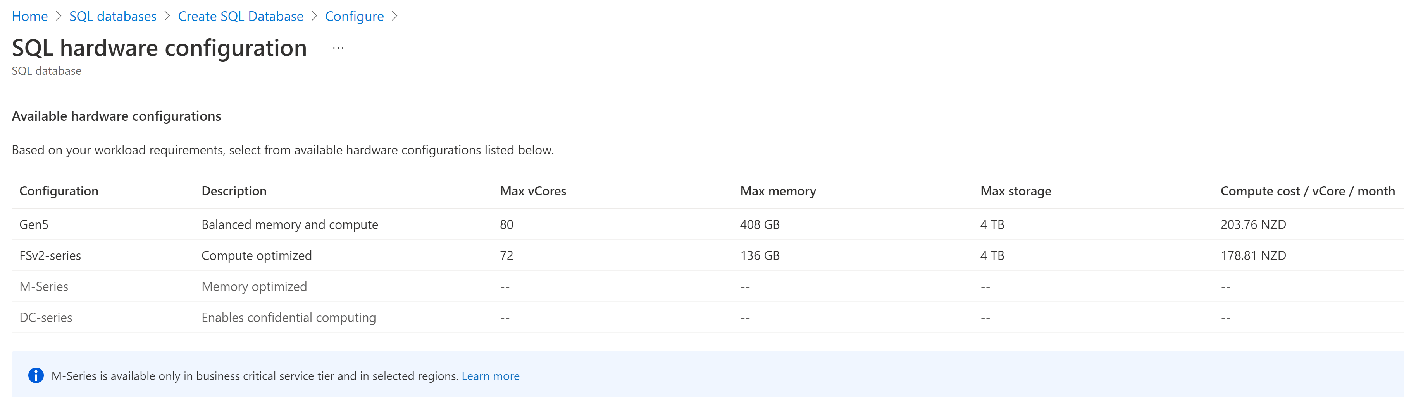
Azure SQL DB - vCore model and service tiers options – General Purpose AU East

Slide 26
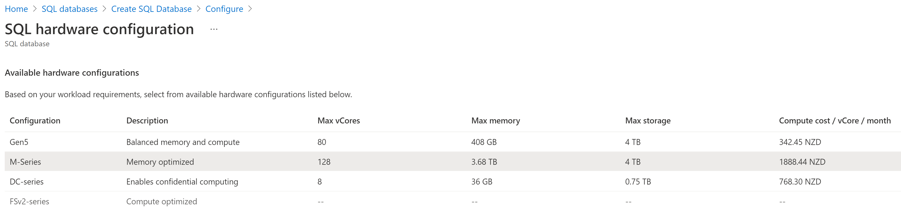
Azure SQL DB - vCore model and service tiers options – Business Critical West US

Slide 27
Service tier characteristics SQL Azure
- | Resource type | General Purpose | Hyperscale | Business Critical
Resource type |  | SQL Database / SQL Managed Instance | Single Azure SQL Database | SQL Database / SQL Managed Instance
Compute size | SQL Database | 1 to 80 vCores | 1 to 80 vCores | 1 to 80 vCores
 | SQL Managed Instance | 4, 8, 16, 24, 32, 40, 64, 80 vCores | N/A | 4, 8, 16, 24, 32, 40, 64, 80 vCores
Storage type | All | Premium remote storage (per instance) | De-coupled storage with local SSD cache (per instance) | Super-fast local SSD storage (per instance)
Database size | SQL Database | 5 GB – 4 TB | Up to 100 TB | 5 GB – 4 TB
 | SQL Managed Instance | 32 GB – 8 TB | N/A | 32 GB – 4 TB
Storage size | SQL Database | 5 GB – 4 TB | Up to 100 TB | 5 GB – 4 TB
 | SQL Managed Instance | 32 GB – 8 TB | N/A | 32 GB – 4 TB
TempDB size | SQL Database | 32 GB per vCore | 32 GB per vCore | 32 GB per vCore
 | SQL Managed Instance | 24 GB per vCore | N/A | Up to 4 TB - limited by storage size
Log write throughput | SQL Database | 1.875 MB/s per vCore (max 30 MB/s) | 100 MB/s | 6 MB/s per vCore (max 96 MB/s)
 | SQL Managed Instance | 3 MB/s per vCore (max 22 MB/s) | N/A | 4 MB/s per vcore (max 96 MB/s)
Backups | All | RA-GRS, 7-35 days (7 days by default). Maximum retention for Basic tier is 7 days. | RA-GRS, 7 days, constant time point-in-time recovery (PITR) | RA-GRS, 7-35 days (7 days by default)

Slide 28
Service tier characteristics SQL MI
 | General Purpose | Business Critical
Number of vCores* | Gen4: 8, 16, 24 Gen5: 4, 8, 16, 24, 32, 40, 64, 80 | Gen4: 8, 16, 24 Gen5: 4, 8, 16, 24, 32, 40, 64, 80
Max memory | Gen4: 56 GB - 168 GB (7GB/vCore) Gen5: 20.4 GB - 408 GB (5.1GB/vCore) Add more vCores to get more memory. | Gen4: 56 GB - 168 GB (7GB/vCore) Gen5: 20.4 GB - 408 GB (5.1GB/vCore) for read-write queries + additional 20.4 GB - 408 GB (5.1GB/vCore) for read-only queries.
Max instance storage size (reserved) | - 2 TB for 4 vCores (Gen5 only) - 8 TB for other sizes | Gen4: 1 TB Gen5: 1 TB for 4, 8, 16 vCores / 2 TB for 24 vCores / 4 TB for 32, 40, 64, 80 vCores
Max tempDB size | Limited to 24 GB/vCore (96 - 1,920 GB) | Up to currently available instance storage size.
Data/Log IOPS (approximate) | Up to 30-40 K IOPS per instance*, 500 - 7500 per file | 10 K - 200 K (2500 IOPS/vCore) Add more vCores to get better IO performance.
Log write throughput limit (per instance) | 3 MB/s per vCore Max 22 MB/s | 4 MB/s per vCore Max 96 MB/s
Data throughput (approximate) | 100 - 250 MB/s per file | Not limited.
Storage IO latency (approximate) | 5-10 ms | 1-2 ms
In-memory OLTP | Not supported | Available, size depends on number of vCore
Read-only replicas | 0 | 1 (included in price)

Slide 29
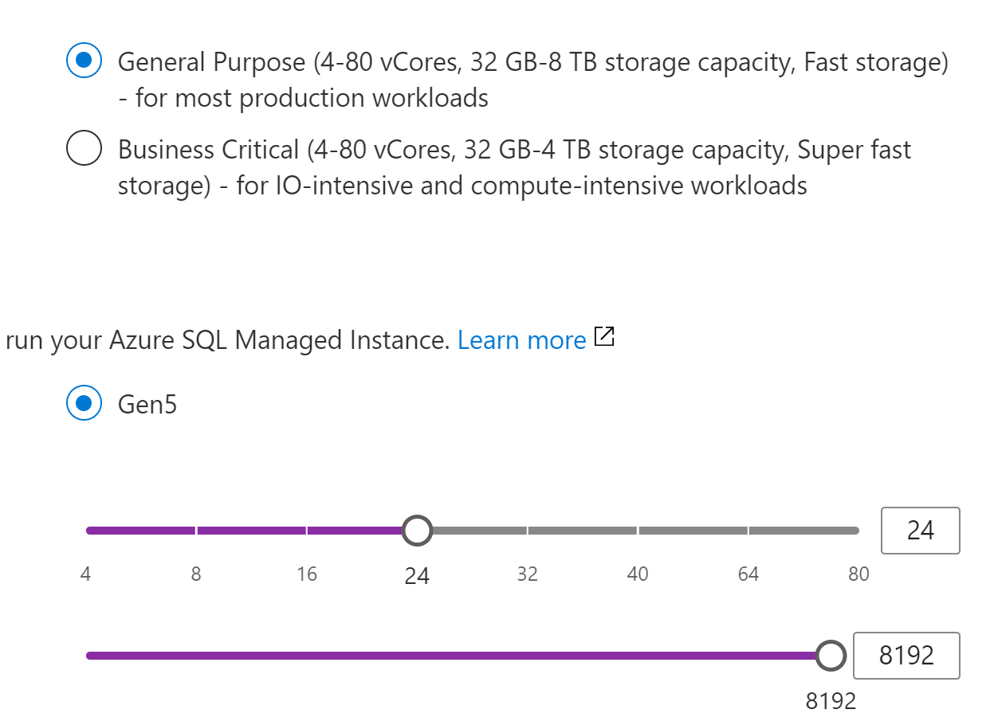
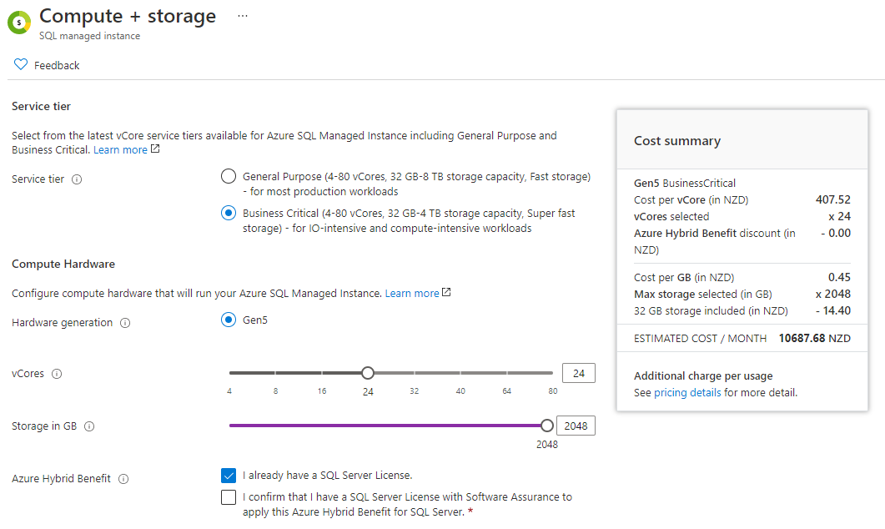
Compute and storage SQL MI
Note
Backup storage, up to the same amount of 2048 GB as data storage, is provided free of charge. Consuming backup storage above this amount is billed per usage. Geo-restore is only available when geo-redundant backup storage is selected.

Slide 30
Azure SQL and Architectural Models
Azure SQL and Architectural Models
Architectural models that are used in Azure SQL
General Purpose service tier availability
Business Critical service tier availability
Read-only replicas and read-only query workloads
Virtual cluster connectivity architecture SQL MI
Custom Architecture Azure SQL DB

Slide 31
Architectural models that are used in Azure SQL
Standard availability model that is based on a separation of compute and storage. It relies on high availability and reliability of the remote storage tier. This architecture targets budget-oriented business applications that can tolerate some performance degradation during maintenance activities.
Premium availability model that is based on a cluster of database engine processes. It relies on the fact that there is always a quorum of available database engine nodes. This architecture targets mission critical applications with high IO performance, high transaction rate and guarantees minimal performance impact to your workload during maintenance activities.

Slide 32
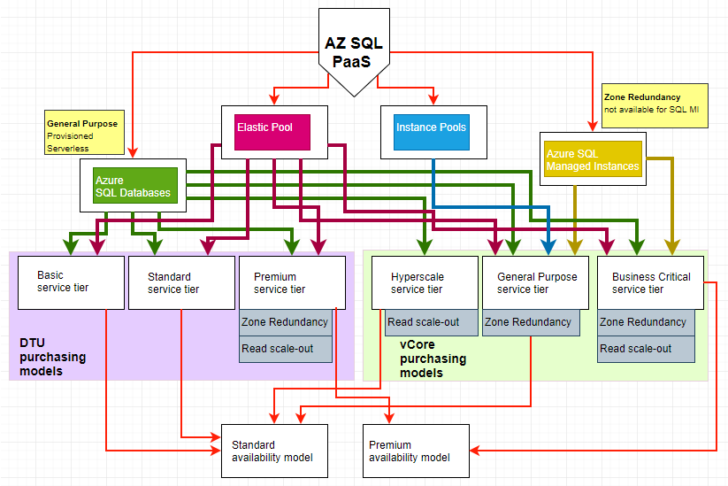

Slide 33
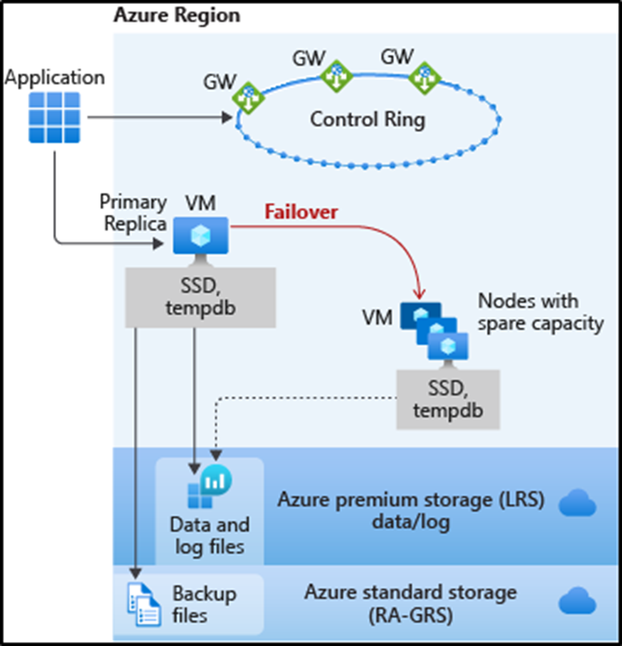
Basic, Standard, and General Purpose service tier locally redundant availability
The standard availability model includes two layers:
Compute layer that runs the sqlserver.exe process (contains only transient and cached data on the attached SSD, such as TempDB, model database, plan cache, buffer pool ).
Data layer with the database files (.mdf/.ldf) that are stored in Azure Blob storage. Azure blob storage has built-in data availability and redundancy feature.

Slide 34
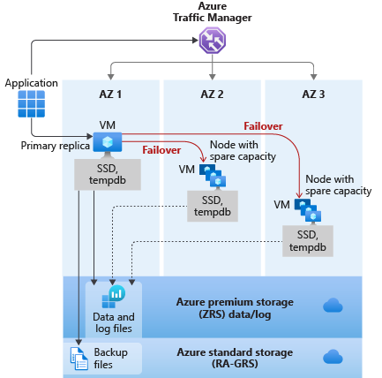
General Purpose service tier zone redundant availability
Notes:
For General Purpose tier, zone redundancy incurs an additional cost.
Zone redundant configuration for serverless and provisioned general purpose tier is only available in some regions.
Zone redundant for General Purpose is currently in Preview. The preview is not covered under Reserved Instance.
Zone redundant configuration is only available when the Gen5 compute hardware is selected.

Slide 35
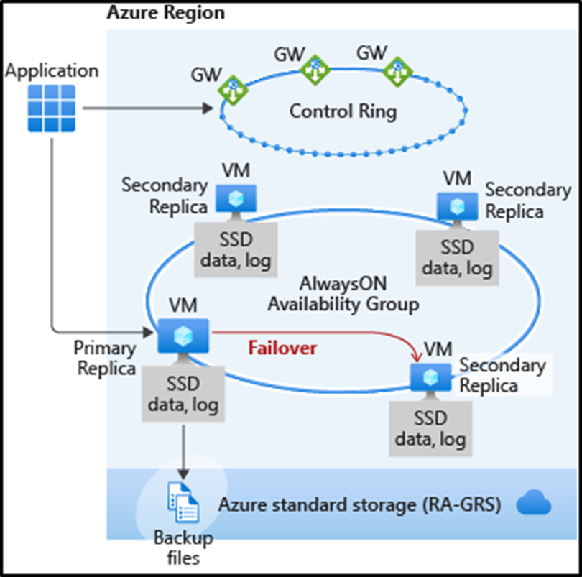
Premium and Business Critical service tier locally redundant availability
Business Critical service tiers leverage the Premium availability model, which integrates compute resources (SQL Server Database Engine process) and storage (locally attached SSD) on a single node.
High availability is achieved by replicating both compute and storage to additional nodes creating a three to four-node cluster.

Slide 36
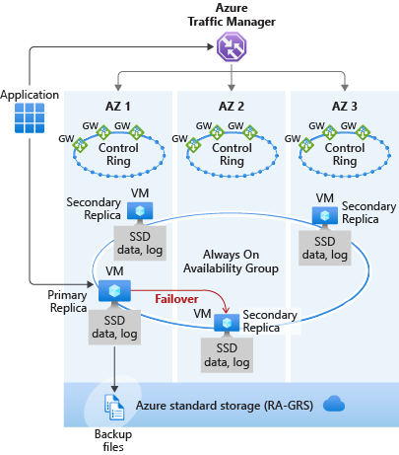
Premium and Business Critical service tier zone redundant availability
Performance impact - Zone redundant databases have replicas in different datacenters with some distance between them, the increased network latency may increase the commit time and affect the performance of some OLTP workloads.
Note
This feature is not available in SQL Managed Instance.

Slide 37
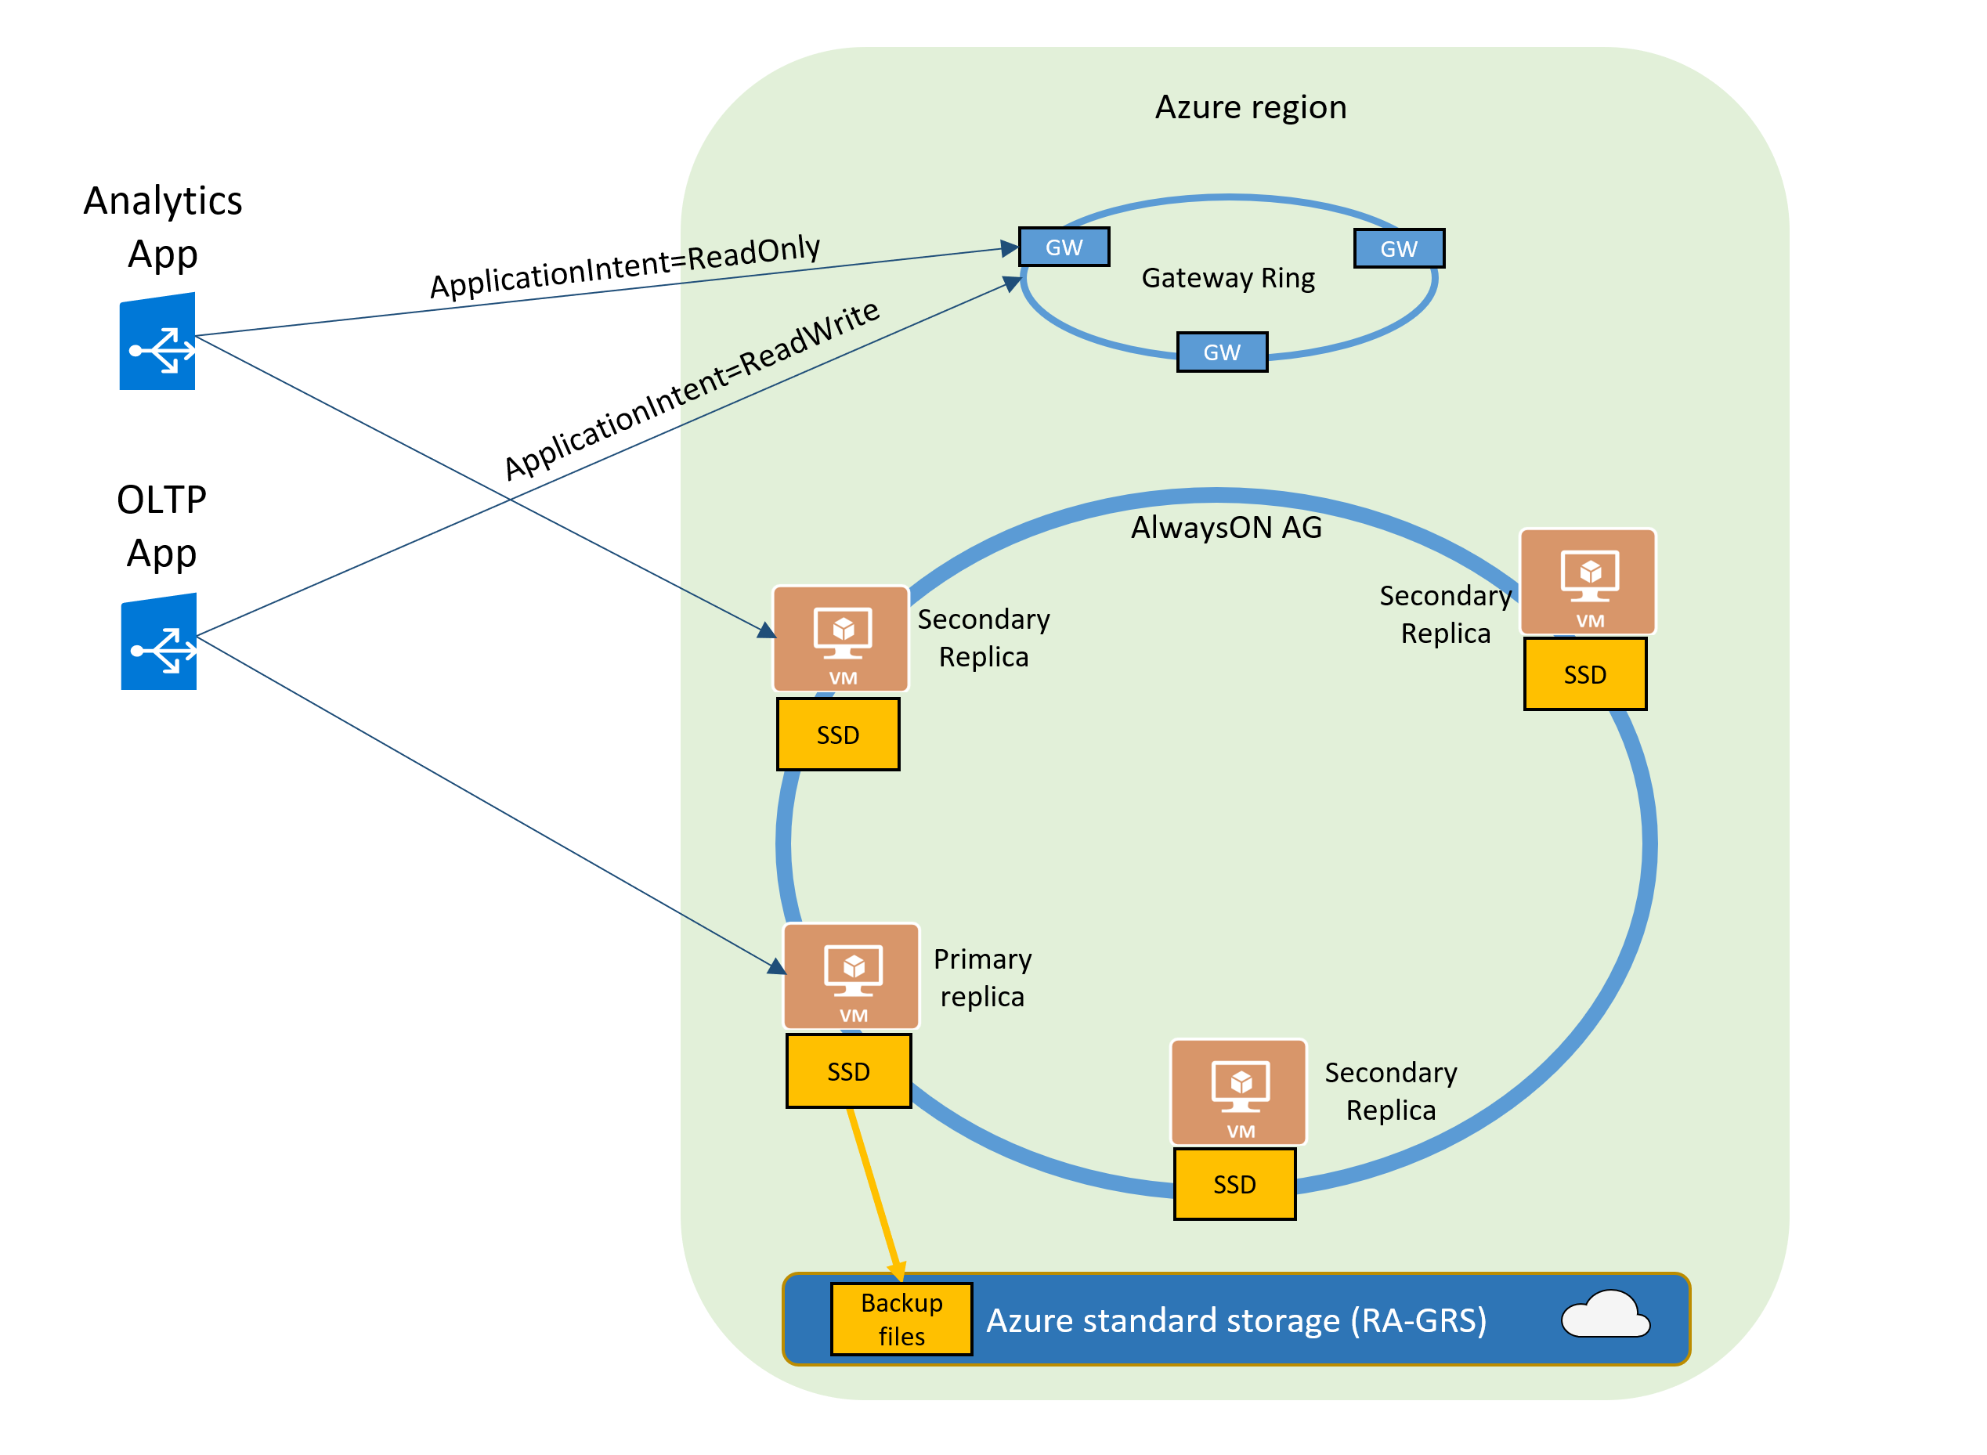
Read-only replicas and read-only query workloads
The Read Scale-Out feature is enabled by default on new Premium, Business Critical, and Hyperscale databases.
In case of Azure SQL Managed Instance it will be Business Critical service tier.
If your SQL connection string is configured with ApplicationIntent=ReadOnly, the application will be redirected by the gateway to a read-only replica of that database.

Slide 38
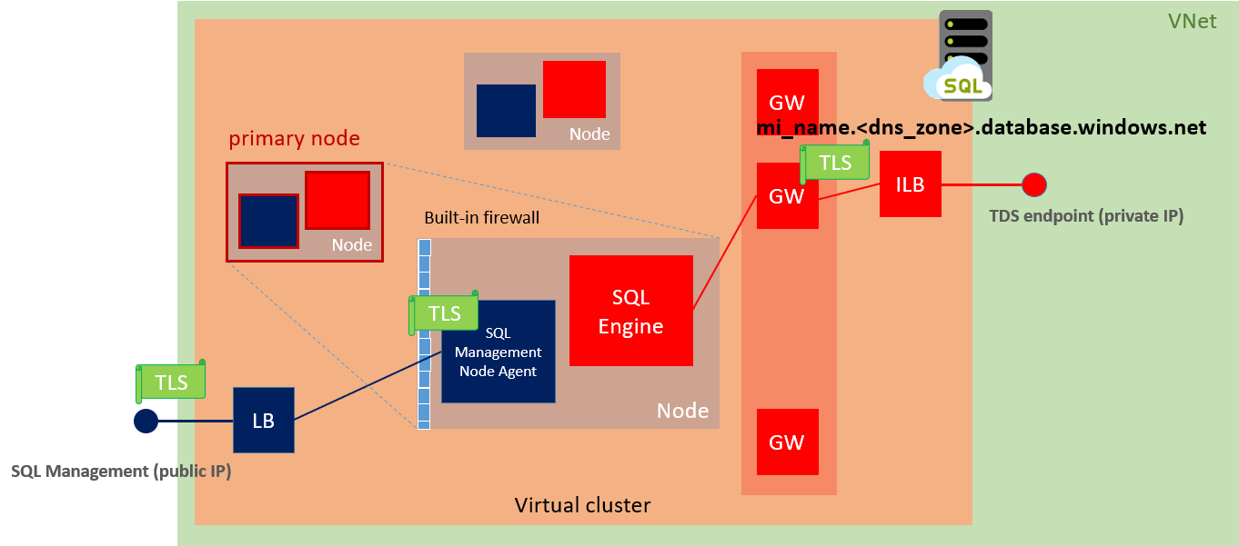
Virtual cluster connectivity architecture SQL MI

Slide 39
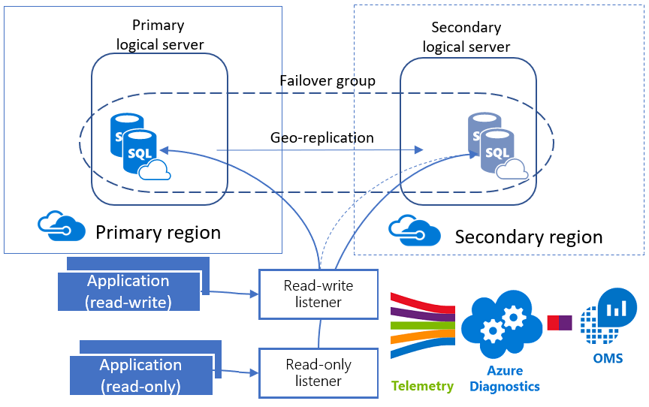
Custom Architecture Azure SQL DB
Use existing or create new Resource Group;
Create primary Azure Logical SQL Server;
Set an admin login and password for your server;
Set Firewall Settings (IP address range);
Create Azure SQL Database;
Create a new login for the Azure SQL Server;
Create a new DB user for the existing login;
Create Failover Azure Logical SQL Server, including admin login, password and firewall rules;
Create Failover Group Name;
Add Database to the exiting Failover Group;
Create a new login for the Failover Azure SQL Server with matching SID;
Create a Workspace in the existing Resource Group;
Enable Azure SQL Analytics Intelligence Pack;
Enable Azure Diagnostics for Azure SQL database;
Configure Azure SQL Databases to stream diagnostics telemetry;

Slide 40
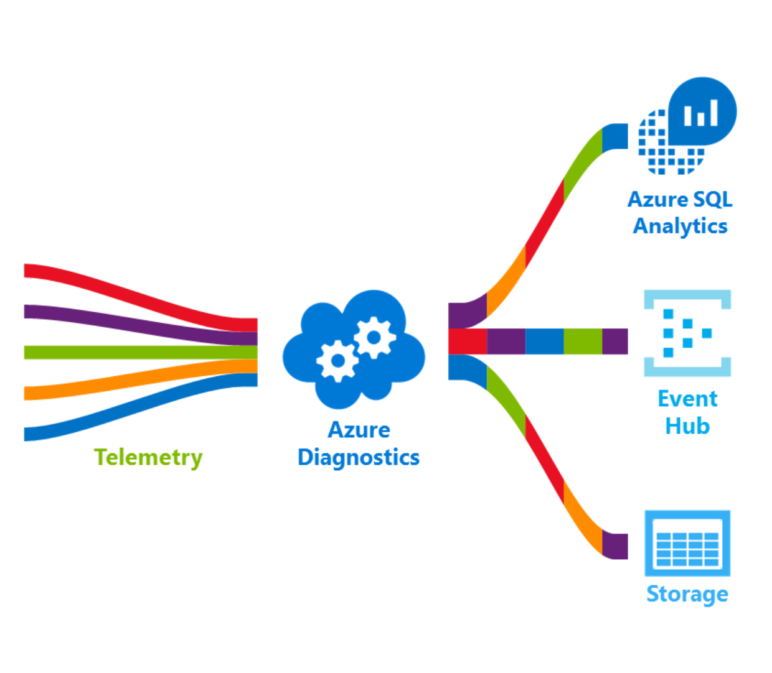
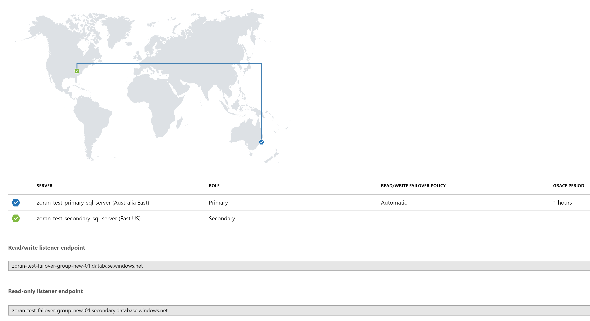

Slide 41
Bonus: Data Migration Assistant (DMA)
DMA main functionalities
Data Migration Assistant (DMA) - Assessment
DMA / Instance Level – Azure SQL Database / Azure SQL MI
SQL Server feature parity – unsupported features example
DMA / DB Level – Azure SQL Database / Azure SQL MI

Slide 42
Data Migration Assistant (DMA)
Using Data Migration Assistant (DMA) tool we can detect potential compatibility issues which may impact our database functionality after migration to Azure SQL managed Instance.
DMA main functionalities:
Discover issues that can affect an upgrade to an on-premises SQL Server
Discover new features in the target SQL Server platform
Migrate an on-premises SQL Server instance to a modern SQL Server instance

Slide 43
Data Migration Assistant (DMA) - Assessment
Assess on-premises SQL Server instance(s) migrating to Azure SQL database(s).
The assessment workflow helps you to detect the following issues that can affect migration and provides detailed guidance on how to resolve them.
Migration blocking issues: Discovers the compatibility issues that block migrating on-premises SQL Server database(s) to Azure SQL Database(s).
Partially supported or unsupported features: Detects partially supported or unsupported features that are currently in use on the source SQL Server instance. DMA provides a comprehensive set of recommendations, alternative approaches available in Azure, and mitigating steps so that you can incorporate them into your migration projects.

Slide 44
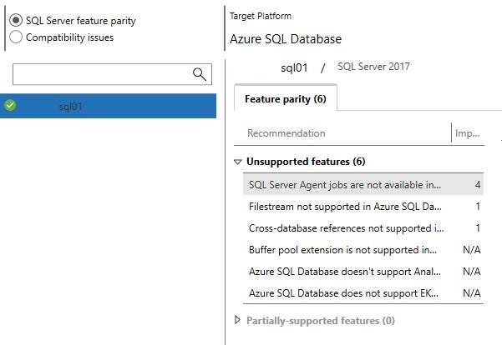
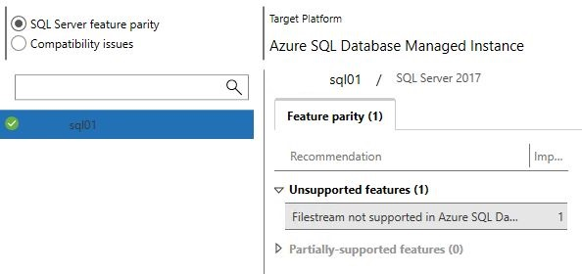
DMA / Instance Level – Azure SQL Database / Azure SQL MI
Azure SQL Database | Azure SQL Managed Instance

Slide 45
SQL Server feature parity – unsupported features example
Azure SQL Database
Buffer pool extension is not supported in Azure SQL Database
Azure SQL Database doesn’t support Analysis Services; migrate to Azure Analysis Services
Cross-database references not supported in Azure SQL Database
Filestream not supported in Azure SQL Database
SQL Server Agent jobs not available in Azure SQL Database
Azure SQL Managed Instance
Filestream not supported in Azure SQL Database

Slide 46
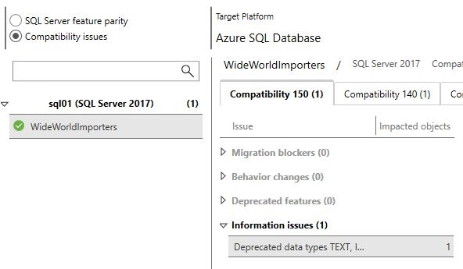
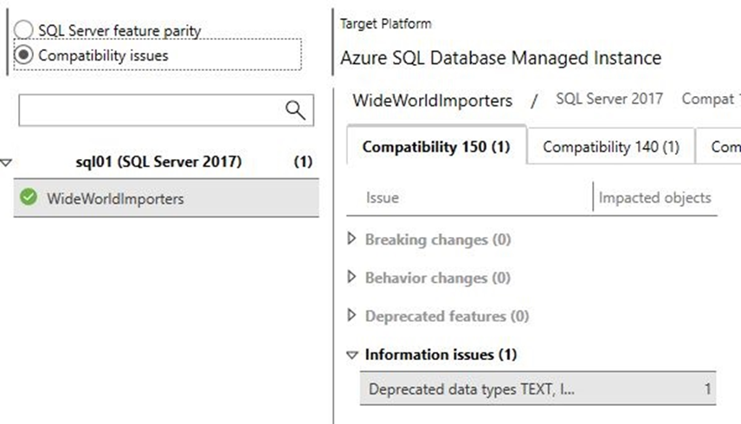
DMA / DB Level – Azure SQL Database / Azure SQL MI
Azure SQL Database | Azure SQL Managed Instance

Slide 47
Q&A
ZORAN BARAC, Principal Data Architect @ CIN7
MCT, MCSE
zoran.barac.zof@gmail.com
blog.sqlserveronline.com
www.linkedin.com/in/zoran-barac/
www.meetup.com/Auckland-SQL-User-Group/

